Slide 1

Programming and Data Visualization for Researchers
[PSY-3035 / HEL-8048]
Workshop 8
James McCutcheon
IPS / Helsefak

Slide 2
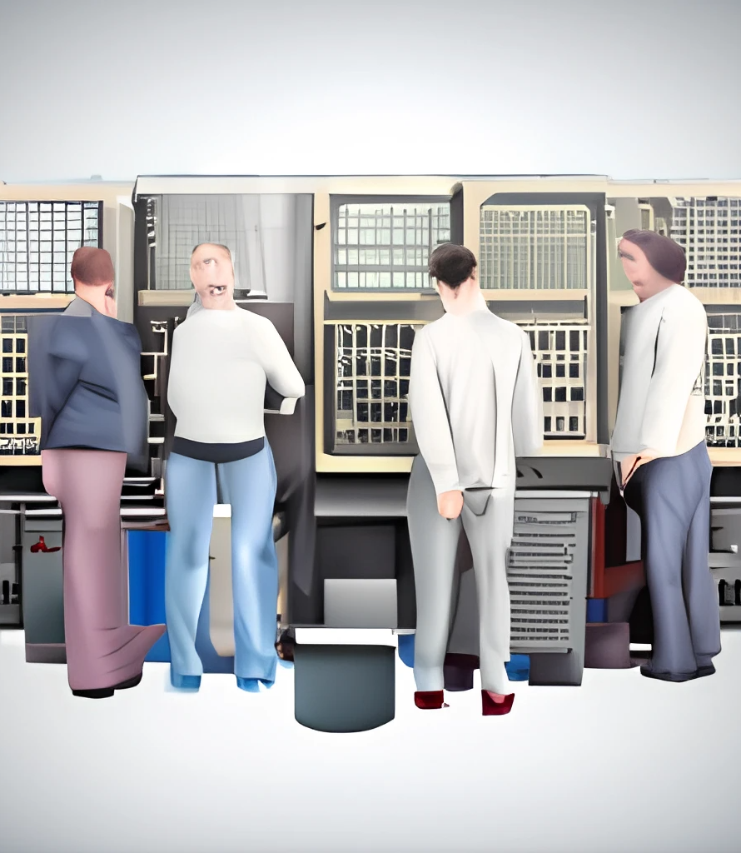
What are APIs?
Application
Programming
Interface
A way of interacting with another program or a source of data.

Slide 3
Restaurant analogy…
API is like the waiter in a restaurant
Shields you from the complexity of all the behind-the-scenes activity
Allows to to get what you want with simple commands

Slide 4
What is a RESTful API?
REST stands for REpresentational State Transfer
A standard allowing us to interact with data on web servers
https://aws.amazon.com/what-is/restful-api/

Slide 5
JSON files
What is a JSON file?
  JavaScript Object Notation
  Originally designed for internet communication between browsers and servers
  Very useful for heirarchical or nested information
  When read into Python becomes a combo of nested dictionaries and lists
  https://www.howtogeek.com/devops/what-is-json-and-how-do-you-use-it/

Slide 6
Important points about interacting with APIs
Do you need a user profile / identifier?
What is the pricing?
How do you generate a response?
Understanding the status codes
How do you navigate through the response?
  Dictionaries, keys and lists
Is it possible to get data using an API for your project?

Slide 7
API tutorial
Here’s an example of a weather API from https://open-meteo.com/
  Free, no API key or sign-up required

Slide 8
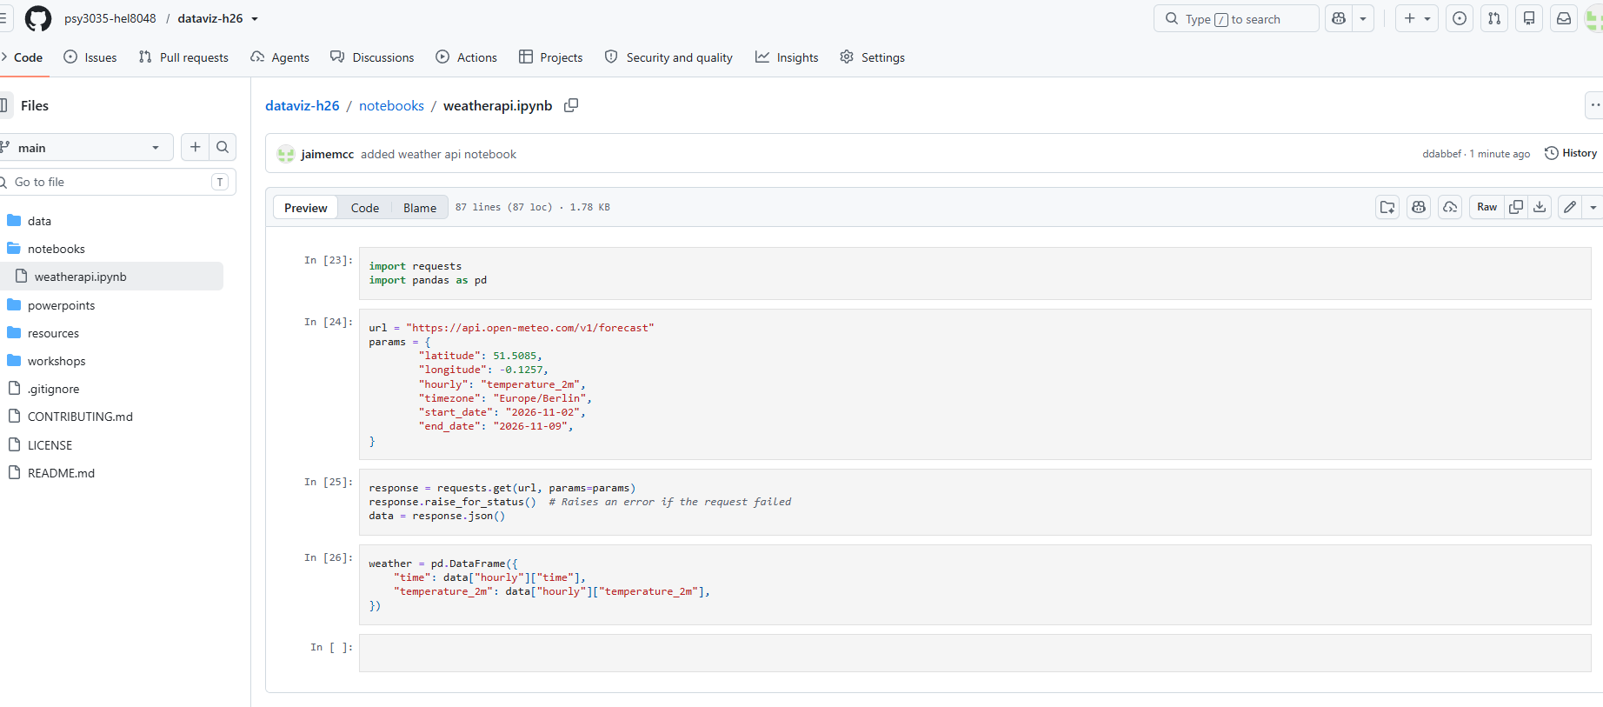



Slide 9
Work with a partner to make a weather graph
You can choose anywhere you want!
You can choose any time or date you want!
You can choose any aspect of the weather you want!
Ask me if you want help with…
  Finding new weather patterns
  Working with pandas timeseries functions
  Specifying different colours etc
  Installing the openmeteo package

Slide 10
Important points about interacting with APIs
Do you need a user profile / identifier?
What is the pricing?
How do you generate a response?
Understanding the status codes
How do you navigate through the response?
  Dictionaries, keys and lists
Is it possible to get data using an API for your project?

Slide 11
API tutorial
You can also look at RapidAPI
  It is a service that gives access to many popular APIs / data sources
  But there are many more different things
  Examples… Spotify, Garmin, weather services
https://deckofcardsapi.com/
https://rapidapi.com/tomorrow-tomorrow-default/api/tomorrow-io1
https://rapidapi.com/googlecloud/api/google-translate1/
https://docs.thecatapi.com/
https://api.adviceslip.com/#endpoint-random

Slide 12

COFFEE TIME

